Slide 1


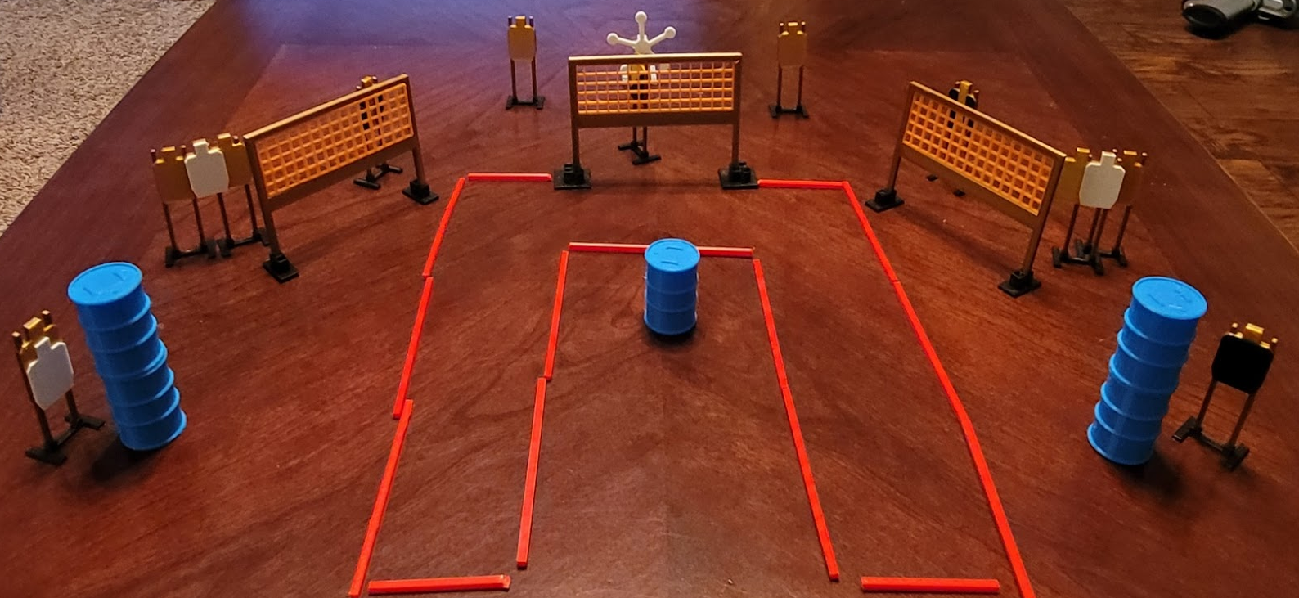
 | Dothan Gun Club – USPSA Match U’re A Star Course Designer : Eric Henwood Bay: A2
Round Count 27 rounds 11 USPSA 5 plates
Equipment List 6 wall feet Texas star 2 tux, 1 headshot, 1 right diag 10 targets (7 + 3 NS)

Slide 2
U’re A Star
Written Stage Briefing
Scoring: Comstock Rounds: 27
Targets: 11 USPSA, 5 steel
Start position: feet on marks, hands touching knees. Firearm is unloaded on barrel, unsupported, trigger guard on mark, muzzle pointed generally at cone. All magazines must start on barrel.
Stage Procedure: on the audible start signal, engage targets as they become available from within the shooting area.

